Slide 1


Deep Learning Methods For Automated Discourse CIS 700-7
Fall 2017
http://dialog-systems-class.org/
João Sedoc with Chris Callison-Burch and Lyle Ungar
joao@upenn.edu
January 26th, 2017

Slide 2
Logistics
Please sign up to present Homework 1
www.seas.upenn.edu/~joao/qc7.html

Slide 4
Neural Network Language Models (NNLMs)
Feed-forward NNLM
Recurrent NNLM
Output
Output
Output
aardvark = 0.000041
aardvark = 0.000054
aardvark = 0.0082
…
…
…
drove = 0.045
to = 0.267
store = 0.0191
…
…
…
zygote = 0.00003
zygote = 0.000009
zygote = 0.003
Hidden 2
Recurrent Hidden
Recurrent Hidden
Hidden 1
Embedding
Embedding
Embedding
Embedding
Embedding
Embedding
he
drove
he
drove
to
the

Slide 7
Notes:
A recurrent neural network is a subclass within recursive NN

Slide 8
Recurrent Neural Networks!!!
This is where we will spend 85% of our time in this course.

Slide 15
Notes:
Markov blanket

Slide 16
Echo State Network

Slide 20
Notes:
Mention open-loop mode and curriculum learning.

Slide 31
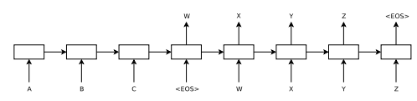
Sequence to Sequence Model
Sutskever et al. 2014
“Sequence to Sequence Learning with Neural Networks”
Encode source into fixed length vector, use it as
initial recurrent state for target decoder model

Slide 32
Sequence to Sequence Model
Loss Function for the sequence to sequence

Slide 33
Long Short Term Memory (LSTM)
Hochreiter & Schmidhuber (1997) solved the problem of getting an RNN to remember things for a long time (like hundreds of time steps).
They designed a memory cell using logistic and linear units with multiplicative interactions.
Information gets into the cell whenever its “write” gate is on.
The information stays in the cell so long as its “keep” gate is on.
Information can be read from the cell by turning on its “read” gate.

Slide 34
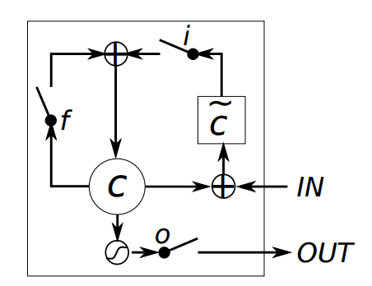
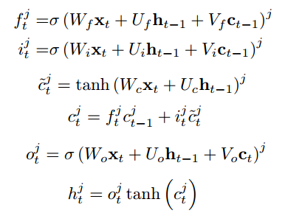
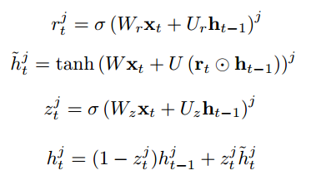
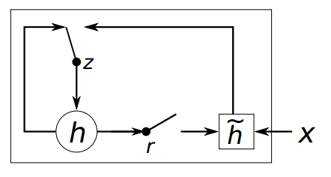
Recurrent Architectures
LSTM/GRU work much better than standard recurrent
They also work roughly as well as one another
Long Short Term Memory (LSTM)
Gated Recurrent Unit (GRU)
Diagram Source: Chung 2015

Slide 35
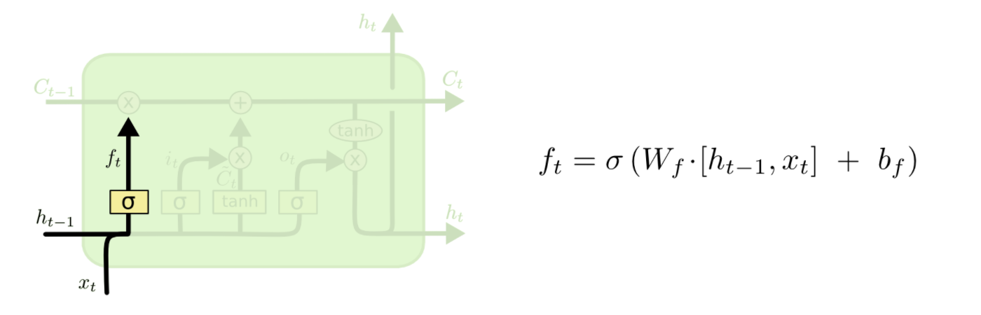
LSTM – Step by Step

Slide 36
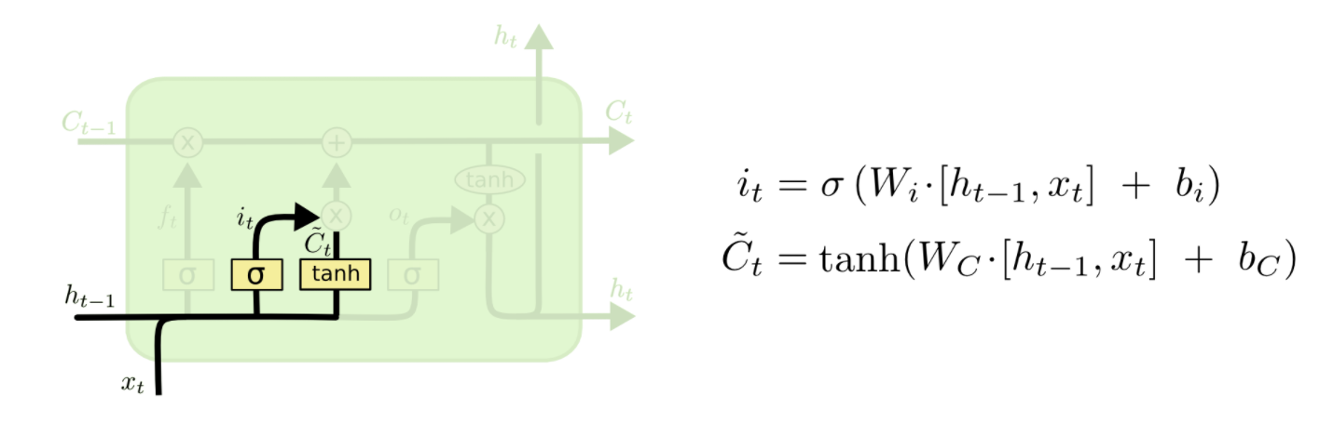
LSTM – Step by Step

Slide 37
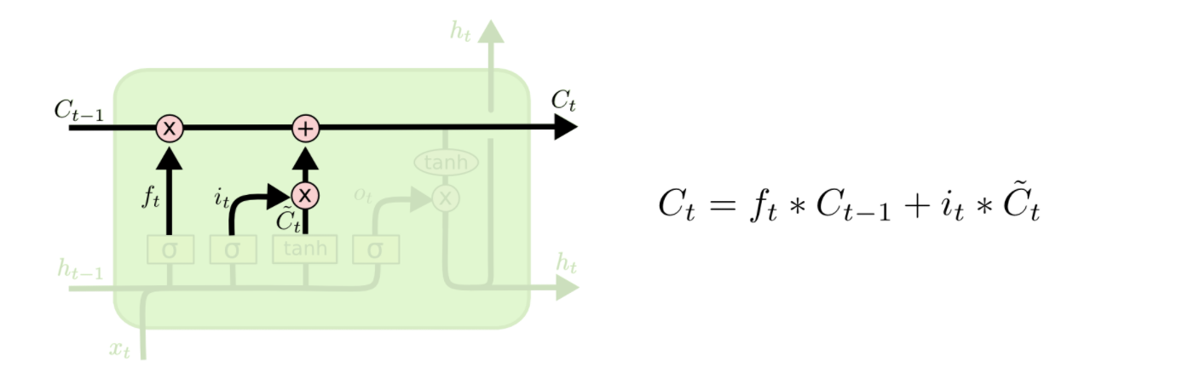
LSTM – Step by Step

Slide 38
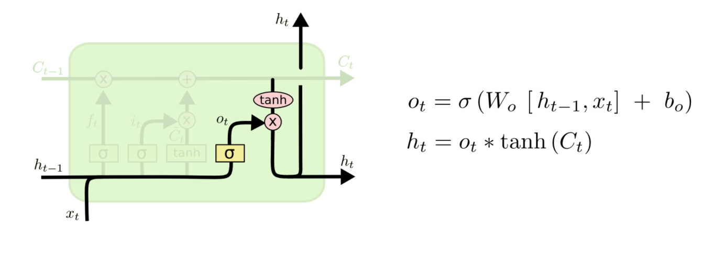
LSTM – Step by Step

Slide 40
Adaptive Learning/Momentum
Many different options for adaptive learning/momentum:
AdaGrad, AdaDelta, Nesterov’s Momentum, Adam
Methods used in NNMT papers:
Devlin 2014 – Plain SGD
Sutskever 2014 – Plain SGD + Clipping
Bahdanau 2014 – AdaDelta
Vinyals 2015 (“A neural conversation model”) – Plain SGD + Clipping for small model, AdaGrad for large model
Problem: Most are not friendly to sparse gradients
Weight must still be updated when gradient is zero
Very expensive for embedding layer and output layer
Only AdaGrad is friendly to sparse gradients

Slide 41
Adaptive Learning/Momentum
For LSTM LM, clipping allows for a higher initial learning rate
On average, only 363 out of 44,819,543 gradients are clipped per update with learning rate = 1.0
But the overall gains in perplexity from clipping are not very large
Model | Learning Rate | Perplexity
10-gram FF NNLM | - | 52.8
LSTM LM w/ Clipping | 1.0 | 41.8
LSTM LM No Clipping | 1.0 | Degenerate
LSTM LM No Clipping | 0.5 | Degenerate
LSTM LM No Clipping | 0.25 | 43.2

Slide 43
Questions
Fig 10.4 illustrates an RNN in which output from previous time stamp is input to the hidden layer of current time stamp. I couldn't understand how is it better than the network described in Fig 10.3 (in which there is connection between hidden units from previous to next time stamp) in terms of parallelization? Won't you have to compute o^{(t-1)} in Fig 10.4 network before you can compute output of o^{(t)?}
Why are input mappings from x^{(t)} to h^{(t)} most difficult parameters to learn?
What do you mean by using a network in open mode?
What are the advantages of adding reset and update gates to LSTM to get GRU?

Slide 44
Questions
How does regularization affects the RNNs where we have a recurrent connection between an output at (t-1) and a hidden layer at time (t), in particular in teacher forcing? Is this related to the disadvantage the books talks about when referring to the open-loop mode?
Why in ESNs we want the dynamical system to be near the edge of stability? Does this mean that we want it as stable as possible, or stable but not too much, to allow for more randomness?
How do we choose between the different architectures proposed? In practice, do people try different architectures, with different recurrent connections, and then with the validation set decide which is the best?

Slide 45
Questions
Is the optimization of recurrent neural networks not parallelizable? Since back propagation with respect to a RNN requires the time ordered examples to be computed sequentially is RNN training significantly slower than other NN training?
Why is this the case: "Unfortunately in order to store memories in a way that is robust to small perturbations the RNN must enter a region of the parameter space where gradients vanish"?
How exactly do all the gates in the LSTM work together?

Slide 46
Questions
The recurrent network learns to use h(t) as a kind of lossy summary of the task-relevant aspects of the past sequence of inputs up to t. In other words, is it identifying important features for prediction?
What method is most commonly used for determining the sequence length? Are there significant pros of it over the others?
The recurrent weights mapping from h(t-1) to h(t) and the input weights mapping from x(t) to h(t) are some of the most diﬃcult parameters to learn in a recurrent network. Why?
Are there any approaches apart from reservoir computing to set the input and recurrent weights so that a rich set of histories can be represented in the RNN state?

Slide 47
Questions
RNNs in general are difficult to parallelize due to its dependence on previous set of iterations. In Bi-directional RNN Fig 10.11, h(t) and g(t) has no connection(arrow) between them as one is capturing the past while other is capturing information from future. Can these two process then be parallelized. ie. Each of forward and backward propagations can run in parallel and then there output is combined ?
What exactly is attention mechanism in seq-to-seq learning ? It is used to avoid the limitation of fixed context length in seq-to-seq, but what is the intuition behind its working ?
In NLP tasks such as Question answering system, I believe Bi-directional RNNs will perform better. My question is: can we use uni-directional RNN (instead of Bi-direction) and feed input sentence and reverse of input sentence separately and sequentially one after the other(without changing the weight matrix). And achieve almost the same efficiency ?

Slide 48
Questions
How much information is just enough information to predict the rest of the sentence in statistical language modeling?
In regards to the Markov assumption that edges should only exist from y(t-k), what is the typical savings computationally and what are the different tradeoffs of different values of k?
Are RNNs with a single output at the end, which are used to summarize a sequence to produce a fixed-size representation, used as a preprocesing step often?

Slide 49
Questions
The chapter notes that cliff structures are most common in the cost functions for recurrent neural networks, due to large amounts of multiplication. What are approaches tailored to RNNs that can draw from lessons around cliff structures and adjust to the uniquely extreme amount of multiplication in RNNs?
The chapter also notes that large weights in RNNs can result in chaos - what lessons from chaos theory can inform how to best deal/understand the extreme sensitivity of RNNs to small changes in the input?
Regarding curriculum learning: how does the technique draw from the most effective techniques for teaching humans, and is there a known reason why curriculum learning has been successful in both the computer vision and natural language domain? Since the computer vision domain has advanced greatly in recent times, how can its techniques be used to best rapidly advance NL?

